Slide 1
Challenge 1
Ticket Incident and Demands
My DFI Challenge
made By: Mohamed Ahmed

Slide 2
Questions ?
Sort out the most used keywords ?
Classify tickets by type (identify types of tickets) ?
Demonstrate time spent by type (statistics) ?
Analyze tickets and provide solutions proposals ?
Develop a module that receives a new ticket and transmits it to the expected teams and propose 5 similar tickets ?
A Voice2Txt interface which receives a text or audio in a chatbot to accept new tickets and deliver the most similar tickets same as point 5 but through a chatbot ?

Slide 3
Dataset Investigation
We will try most important columns for our problems and what mistakes and missing observation.
Reading the xlsx file As Dataframe.
From dataset frame seem there are a 89,058 Row Sample, 28 as observation as features and 1 more as ID.
Most of observation features as object type(str) and others are int (int64).
There is some rows having missing observations [Charge estimée , Action-Time, ….].

Slide 4
Dataset Investigation
From Investigation we are interested in some columns
For All Previous Questions except #3 will use those columns ["Type", "Team", "Incident-Subject", "Ticket-Description“]
For Questions 3 Will use those columns ["Type", "Creation-date", "update-date", "Validation Time", "Treatment Date", "Action-Time", "Wait Time"].
Will create dataframe mask for each of previous sets for building Analysis and Models for classification and clustering

Slide 5
Dataframe 1 Preprocessing
Dropping Nan observation form columns ["Incident-Subject", "Ticket-Description”].
From reading samples we discover some useless word that will not effect or add any vales to our models like {u'\xa0', "bonsoir", "bonjour", …}.
Lowercase every vocabulary.
Tokenize every observation to set of vocabulary.

Slide 6
Languages WordNet
Using Some Packages and functions to remove the stop words and return every word semantic for each known language like {English, French, Russian} some other language discovered like Chinese.
Will keep the digits and unknown words like server names.
Now we have a vocabulary vector for each observation.
Then Will Use “Tfidfvectorizer” That aim convert row vectors to a matrix of TF-IDF features.
After That we can have the dictionary of used word in our up coming model and answering questions

Slide 7
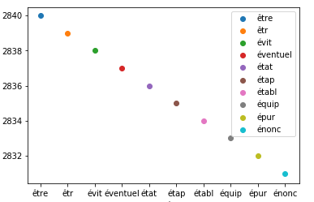
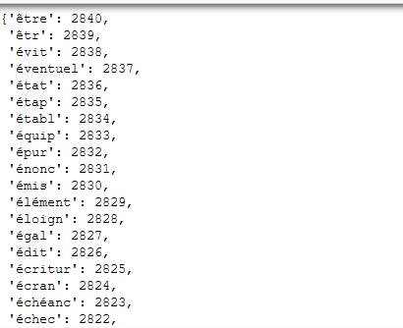
Q1-Sort out the most used keywords ?
By sorting the “tdfi” items that contain the word and number of occurrence in our dataset we can answer

Slide 8
Q2- Classify tickets by type (identify types of tickets) ?
Split our dataset to train and test
Training set will be 70% and test set 30%.
Our labels will be the type of ticket and will encode it to 0 or 1 as a binary classifier.
Applying the support vector machine with kernel of polynomial function of degree 5.
Our accuracy from random seed from 80% to 90%.

Slide 9
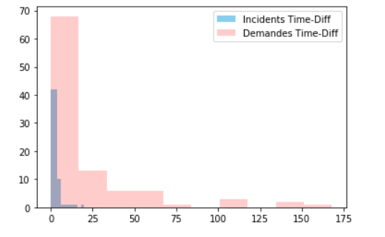
Q3- Demonstrate time spent by type (statistics) ?
As we Say most of our columns come in object data type.
So we convert the {Creation-date, Treatment Date}, assuming that the created problem date and second is closed ticket for this problem.
We will add one more column as difference between start and end date time.
This Figure Is First 100 Sample.

Slide 10
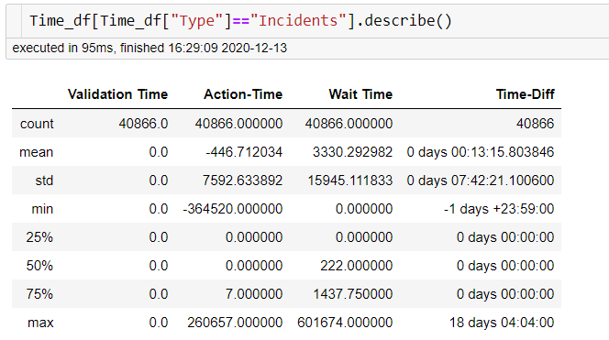
Time Analysis For Incidents
Time difference between create date and end date
Max: 18 days 4 h 4 min.
Mean: 13 min
Action time
Max: 260657 Min.
Mean: -446 !
Wait time
Max: 601574 min
Mean: 3330 min

Slide 11
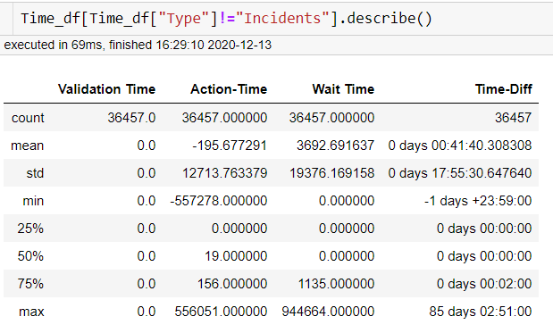
Time Analysis For Demand
Time difference between create date and end date
Max: 85 days 2 h 51 min.
Mean: 41 min
Action time
Max: 556051 Min.
Mean: -195 Min!
Wait time
Max: 944664 min
Mean: 3692 min

Slide 12
Time Analysis Conclusion
Almost will do the same for {Action-Time, Wait time, Validation Time}.
And We Get This
Demand Ticket Take More time Than Incidents Time Difference.
Demand Ticket Take More time Than Incidents Wait Time.
Both Demand, Incidents skew right That mean most of tasks end fast.

Slide 13
Q4- Analyze tickets and provide solutions proposals?
Classify tickets by type (identify types of tickets) ?
From the words vector we created will use our Tfidf-matrix and get the features vectors.
Applying simple cousin similarity multiplication between test feature vector and training feature vector
Sort the wights and get the arg max index for it and then return to training set with this index and extract the [ticket discretion] and this will be our result of similar solution
Will Extend This Solution With LSTM as encoder/decoder module

Slide 14
Q5- Develop a module that receives a new ticket and transmits it to the expected teams and propose 5 similar tickets ?
Clustering our training data but will extend it with our Labeling column with k-mean nearest neighborhood with k=5.
Our Decision will come from lowest Distance between test case and training set.

Slide 15
Q6- Develop a module that receives a new ticket and transmits it to the expected teams and propose 5 similar tickets ?
By using Speech Recognition as our interface to transform voice to text.
There was an error with installing pyaudio to get voice from microphones.
I test it by uploading a audio file to Speech Recognition and return to test on previous model of knn to get similar tickets.
Adding an option to chose to input the test by voice(audio) or text chose 1 for text or 2 for audio.

Slide 16
Question And answering With LSTM
Will use lstm encoder of the questions, and decoder the answers seq2seq.
Will add to {Incident-Subject, Ticket-Description} tag of start and another for end.
For every row will split it to sentences, and split every sentence to vocab.
Getting the max sentence length and the pad the empty to make every sentence have same length for questions and answers

Slide 17
Decoder and Encoder
Questions is our input encoder.
Answers is our input to decoder.
Answers is our output decoder.
Model will contain:
Encoder:
Input layer with input shape(, Max length of question, ).
Using Embedding layer and will apply Embedding matrix with (200 feature vector) multiplication.
Add LSTM layer with 200 unit.
Decoder:
Input layer with input shape(, Max length of answers, ).
Using Embedding layer and will apply Embedding matrix with (200 feature vector) multiplication.
Add LSTM layer with 200 unit
Using fully connected layer with num of vocabularies in our data set

Slide 18
Compile LSTM Encoder/Decoder
Compile Previous Model with
Adam Optimizer to vest for gradient descent and automatic converge using momentum
Train this model with
Batch size = 200.
Epochs = 100.
save model after each epoch and stop when no change in validation loss after 5 epochs.

